Slide 1
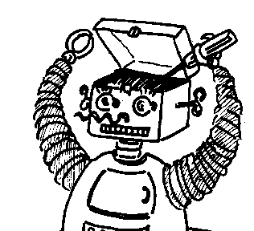
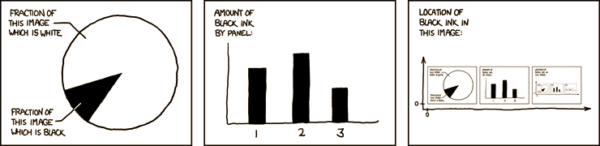

Maryland Metacognition Seminar
http://xkcd.com/
Toward an integrated metacognitive architecture
Michael T. Cox
UMIACS, University of Maryland, College Park
8 JULy 2011, 12:00 PM
A. V. Williams Bldg., RM. 3258, College Park
Abstract:
Many researchers have implemented models of cognition and metacognitive activity in various architectures to test and better define specific theories of metacognition. However current theories and implementations suffer from numerous problems and lack of detail. Here we illustrate the problems with two different computational approaches. The Meta-Cognitive Loop and Meta-AQUA both examine the metacognitive reasoning involved in monitoring and reasoning about expectation failure, and they both learn from such experiences. But neither system presents a full accounting of the variety of known metacognitive phenomena. The problem is that no existing cognitive architecture directly addresses metacognition. Instead current architectures were initially developed to study more narrow cognitive functions and only later were they modified to include higher level attributes. I claim that the solution is to develop a metacognitive architecture outright, and I outline the structure that such a foundation might have.

